Slide 1


InventoryMax: A Product Management Capstone Project Focused on Optimizing Inventory Management: A Tailored App Solution for Small Scale Businesses in Nigeria
Presented by
Forstina John-Omonkhodion

Slide 2
PRODUCT VISION
To empower small-scale businesses in Nigeria to optimize their inventory management, streamline operations, and drive growth through a user-friendly, automated, and data-driven platform.

Slide 3
A Concise Description of the Product
Inventory Management is crucial for small-scale businesses in Nigeria. It involves tracking stock levels, orders, and sales. An efficient system can enhance profitability and customer satisfaction, ensuring businesses meet demand without overstockingking
Introducing InventoryMax, a simple and affordable inventory management solution designed specifically for small-scale businesses in Nigeria. Our app helps entrepreneurs:
Track stock levels in real-time
Automate inventory tracking and reporting
Set alerts for low stock and expiration dates
Optimize storage and reduce waste
Make data-driven decisions to improve profitability
With InventoryMax App, say goodbye to manual errors, stockouts, and overstocking. Take control of your inventory and focus on growing your business.

Slide 4

Market Research and Analysis Market Research using Interview Empathy Mapping
First step to understanding my customer is User Research. This will help me to understand my target audience
The Goal of Empathy Mapping for the Product: InventoryMax
1. To understand the pain points and challenges in current inventory management processes.
2. To identify motivations and goals for using InventoryMax.
3. To uncover area needs and opportunities for improvement.
4. To develop user personas to guide product development and marketing.
Empathy Questions Asked
WHY? (The idea behind the question “Why” is for Motivations and Goals)
1. Why do you use inventory management software?
- Answer: To streamline operations, reduce errors, and improve profitability.
2. What are your biggest challenges with current inventory management processes?
- Answer: Manual data entry, stockouts, overstocking, and lack of real-time visibility.
3. Why is inventory management important to your business?
- Answer: To ensure customer satisfaction, reduce waste, and optimize resources.
Interactive Discussions

Slide 5

Interactive Discussions
HOW? (The idea behind the question “How” is to understand their Current Behaviors and Workarounds)
1. How do you currently manage inventory?
- Answer: Spreadsheets, manual counting, and periodic audits.
2. What tools or software do you use for inventory management?
- Answer: Basic accounting software, spreadsheets, or legacy inventory systems.
3. How do you handle inventory discrepancies or errors?
- Answer: Manual reconciliation, adjustments, and sometimes write-offs.
WHAT? (The idea behind the question “What’ is uncover their Needs and Expectations)
1. What features do you expect from an ideal inventory management solution?
- Answer: Real-time tracking, automated reporting, and integration with e-commerce platforms.
2. What are your must-haves for inventory management software?
- Answer: Ease of use, accuracy, and scalability.
3. What would make your inventory management process more efficient?
- Answer: Automation, mobile accessibility, and customizable reporting.
WHEN? (The idea behind the question “When” is to know the Timing and Frequency)
1. When do you typically perform inventory audits or counts?
- Answer: Quarterly, annually, or after significant inventory changes.
2. How often do you update inventory records?
- Answer: Daily, weekly, or monthly, depending on sales volume.
3. When do you experience the most inventory management challenges?
- Answer: During peak sales periods, holidays, or supply chain disruptions.

Slide 6

Follow-up Questions:
User 1. – Joseph – Operations Manager
QUS: Can you walk me through your current inventory management process?
ANS: “Our current process is mostly manual. We use a combination of spreadsheets, paper records, and basic accounting software to track inventory.
- When we receive our goods, we manually update our spreadsheets.
- We periodically conduct inventory counts to reconcile discrepancies.
- We manually update our website and online marketplaces when inventory levels change.
This is time-consuming for us, its prone to errors, and does not provide real-time visibility into our inventory levels”.
User 2 – Emily – Business Owner
QUS: How does inventory management impact your customer relationships?
ANS: "Inventory management has a direct impact on our customer relationships. When we are out of stock, we disappoint our customers, and this will lead to:
- Lost sales
- Negative reviews
- Decreased customer loyalty
- Increased customer support queries
User 3 – John – Inventory Manager
QUS: What are the consequences of inventory errors or stockouts?
ANS: "The consequences are severe:
- Lost revenue
- Increased costs
- Destroys customer relationships
- Negative online reviews
- Reduced competitiveness

Slide 7


User 4 – Glory – Business Owner
QUS: Have you considered integrating inventory management with other business systems?
ANS: As a matter of fact "Yes, we've explored integrating inventory management with:
- E-commerce platforms (Shopify, WooCommerce)
- Accounting software (QuickBooks)
- Supply chain management tools
However, our current system lacks API connectivity, making integration challenging. We'd love to see seamless integration with InventoryMax." (Painpoint)
Empathy Mapping Tools:
1. User interviews
2. Surveys

Slide 8
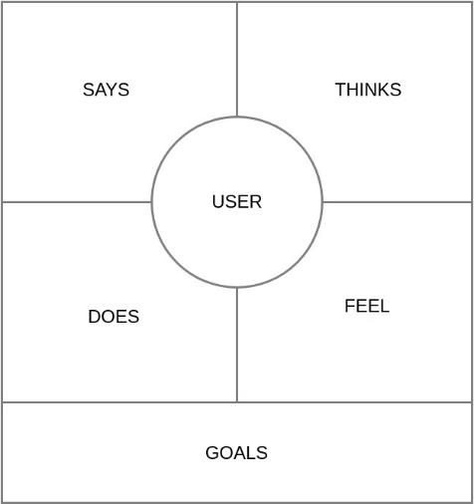
User Persona: Daily Key Activities, Behavioural Statement, Pain-Points and Need Statement are noted down during the interviews
Daily Key Activities:
1. Monitoring inventory levels
2. Processing orders and shipments
3. Conducting inventory audits
4. Managing supplier relationships
5. Analyzing sales data
Behavioral Statements:
1. "I spend too much time manually counting inventory and reconciling discrepancies."
2. "I struggle to keep track of inventory levels across multiple warehouses."
3. "I'm constantly worried about stockouts and overstocking."
4. "I wish I had real-time visibility into inventory levels and sales trends."
5. "I'm frustrated with the lack of automation in our current inventory management system."
Pain Points:
1. Manual data entry and reconciliation
2. Lack of real-time inventory visibility
3. Inaccurate inventory forecasting
4. Insufficient automation
5. Difficulty scaling inventory management
Need Statements:
1. "I need an automated inventory management system that accurately tracks inventory levels in real-time."
2. "I need a centralized platform to manage inventory across multiple warehouses."
3. "I need predictive analytics to optimize inventory forecasting and minimize stockouts."
4. "I need seamless integration with our e-commerce platform and accounting software."
5. "I need customizable reporting and dashboards to inform business decisions."

Slide 9


Empathy Map
Name: Joseph
What does he THINK?
- "I wish I had real-time visibility into my inventory levels."
- "I'm worried about stockouts and overstocking."
- "How can I optimize my inventory management process?"
- "I need to reduce errors in my inventory tracking."
What does he FEEL?
What does he DO?
1- Manually track inventory using spreadsheets
- Use multiple systems for inventory management
- Conduct physical inventory counts
- Adjust orders based on intuition
- Frustrated with manual tracking
- Overwhelmed by inventory complexity
- Anxious about stock levels
- Disappointed with current system
user
What does he SAY?
- "I'm tired of manually tracking inventory."
- "Our current system is too complicated."
- "We're losing sales due to stockouts."
- "I need a more efficient way to manage my inventory."
Pain
Goal
.1. Manual data entry and reconciliation
2. Lack of real-time inventory visibility
3. Inaccurate inventory forecasting
4. Insufficient automation
5.Difficulty scaling inventory management
- Achieve accurate real-time inventory tracking
- Optimize inventory levels and reduce waste
- Streamline inventory management process
- Increase efficiency and reduce costs

Slide 10
Survey Empathy Mapping : Analyzing Feed Back From Google Form
Name: | Email: | What is your role in | What type of products does | How do you currently | What are the biggest challenges you face | How often do you experience | What features would you expect | How Important is real-time | How important is ease of use to you | Are there any specific pain points or | Any additional
 |  | your organization? | your organization sell or manage? | manage your inventory? | with your current inventory management system? | stockouts or overstocking? | from an inventory management app? | inventory tracking to your business? | when it comes to inventory management software? | challenges you'd like the app to address? | comments or suggestions?
Okoro John Omonkhodion | akjeremyjt@gmail.com | General Manager | Properties | Software | Interconnectivity | Once in a while | Automation | Very Important | Very Important | Flexibility of use
Olaade Timothy Oluwafemi | timothyolaade@gmail.com |  | My organization is a faith base | Software | Management of people | Not very often | Automation | Extremely Important | Extremely important | Nill | Nill
Daniel Aikhomogbe | daikhomogbe@gmail.com | Marketing | Kitchen/home appliances |  | No clear Data and previous check | Every time | Tracking | Extremely Important | Extremely important | Keeping of records and tracking | None
Muyiwa Olaniyi | muyiwaofjesus@gmail.com | Business Owner | Household items | Manual Counting | Running out stock | Every time | Reporting | Very Important | Extremely important | Ability to notify when stock is running out
Ojeniyi bukola | buquienterprises@gmail.com | Business Owner | Household products | Manual Counting | You suddenly noticed that a product is suddenly not in stock. | Once in a while | Tracking | Extremely Important | Extremely important
Rosemary Michael | rosmariziel@gmail.com | Business Owner | Baked goods | Software | App failure | Not very often | Tracking | Very Important | Extremely important
Adewale | Wale.williams91@yahoo.com | Machine operator | Sim cards | Spreadsheet |  | Not very often | Automation | Somewhat Important | Very Important
Samuel | Ifypsalm@gmail.com | Operations Manager | Foods | Manual Counting | time consuming | Once in a while | Automation | Very Important | Very Important | None for now | No
Micheal Ifeanyi | michealmic00@gmail.com | Engineer | Telecommunications | Spreadsheet | Collating of data | Not very often | Automation | Very Important | Very Important | Data referencing
MOGAJI Damilola | dammy2shoes@gmail.com | Business Owner | Leather bag and accessories | Manual Counting | Loss of count | Not very often | Tracking | Very Important | Very Important;Somewhat Important | Tracking sales | Reducing overstocking
Jesuware Esther | mayowaoni89@gmail.com | Business Owner | Educational books | Manual Counting | Taking stock | Every time | Reporting | Somewhat Important | Very Important
Felix Okon | felixokon19@gmail.com | Business Development Mgr | Artificial plants, grass and fiberglass pots | Software | No idea | Once in a while | Automation | Somewhat Important | Somewhat Important | No | No
Oremade Yemisi | yemisiores@gmail.com | Operations Manager | Human | Spreadsheet | Incorrect entries | Once in a while | Automation | Extremely Important | Very Important
UnboxNg Logistics | unboxnglagos@gmail.com | Operations Manager | LOGISTICS SERVICE | Spreadsheet | TIME MANAGEMENT | Never | Tracking | Very Important | Very Important | NO | NO
Eniola kazeem | keniola914@gmail.com | Business Owner | Mechanical engineering | Manual Counting | Afraid to loss | Not very often | Reporting | Very Important | Very Important | No | No
Godbless Isaiah Eddie | godblessisaiaheddie@gmail.com | Operations Manager | Chicken | Software | Country's economy instability | Once in a while | Reporting | Very Important | Somewhat Important | Mobility of goods
kenneth Ogbebor | ogbebor10@gmail.com | Business Owner | Real Estate | Spreadsheet | Difficult to track changes in real time | Every time | All the above | Extremely Important | Extremely important | Remote access
Femi | femiiadedayo@gmail.com | Business Owner | Biscuits | Spreadsheet | Not automated | Once in a while | Automation | Extremely Important | Extremely important | Notify when stock is at a certain threshold
michael fatunase | mfatunase@gmail.com | Operations Manager | SIM Cards manufacturing | Spreadsheet | No major issues | Never | Tracking | Extremely Important | Very Important
Oluwaseun Adefuye | Oluwaseunadefuye@yahoo.com |  | Groceries |  | Inability to track down bit by bit quantity | Once in a while | Reporting | Extremely Important | Somewhat Important | Ability to update stock frequently
Onubiyi Adamaka | ezeukwuadamaka@gmail.com | Business Owner | Food items | Software | Network issues sometimes | Never | Tracking | Somewhat Important | Extremely important | Network management
Olusogo Aguda | olusogoa@gmail.com | Business Owner | Shoes and clothes | Manual Counting | Frequent arrangement of items | Once in a while | Tracking | Very Important | Very Important | Not really | The app should be user friendly
Adekunle Adefuye | Adekunleadefuye@yahoo.com | Branch Manager | Financial services | Software | None because it is fully automated | Never | Automation | Extremely Important | Extremely important | None | None
YETUNDE ABOLARIN | abolarinyetunde79@gmail.com | Operations Manager | Books | Manual Counting | Reconciliation | Once in a while | All of the above | Extremely Important | Very Important | Reconciliation of stock based on first in , first out | Ease usability of product.
Greg | Gregojie1@gmail.com | Operations Manager |  | Software | Cost of maintenance | Once in a while | Automation | Extremely Important | Extremely important | Simplicity in usage
Damilola | Dolydamy@gmail.com | Accountant | Fabrics | Software | Non | Once in a while | Automation | Extremely Important | Extremely important | Tracking | No
Abioye Aanuoluwa | abioyeaanuoluwa@gmail.com | Business Owner | Confectioneries | Spreadsheet | Stress of input | Every time | Automation | Somewhat Important | Very Important | Notification bell or tone | Nill
Fabunmi ibironke | ronkes_7@yahoo.com | Business Owner | Consumable goods | Manual Counting | Inaccuracy | Every time | Reporting | Very Important | Very Important | Ability to detect expired date | None
Joel Michael | cherrystouch@gmail.com | Product Designer | Innovation | Software | Demand forecasting | Not very often | Tracking | Extremely Important | Very Important |  | Non
Olanrewaju Omowunmi | mosfluffycakes@gmail.com | Business Owner | Baking | Manual Counting | Space | Not very often | Reporting | Very Important | Very Important | No | No
Olawunmi Olaade | oluwasikemi1981@gmail.com | Business Owner | Provisions | Manual Counting | The inventory is not always accurate | Not very often |  | Extremely Important | Extremely important
Oue | oyeojeniyi@yahoo.com | Operations Manager | Soap | Manual Counting | Counting the products | Once in a while | Automation | Extremely Important | Extremely important | Accuracy | None

Slide 11
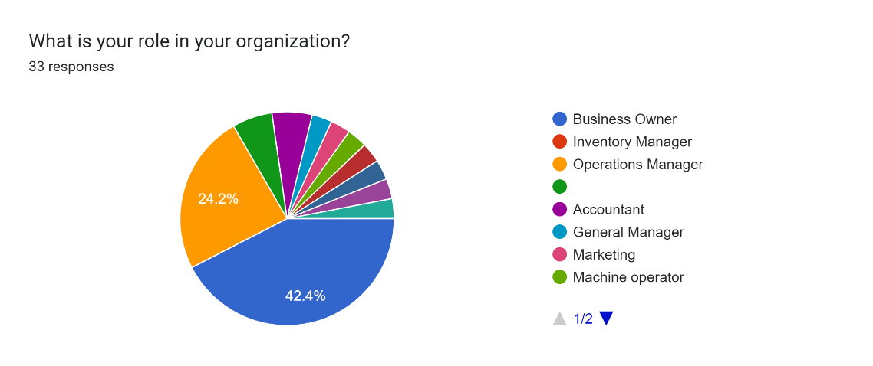
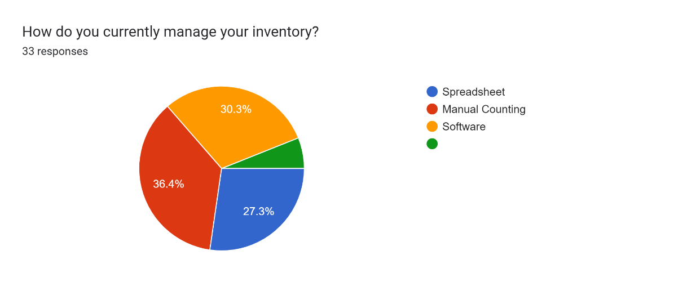
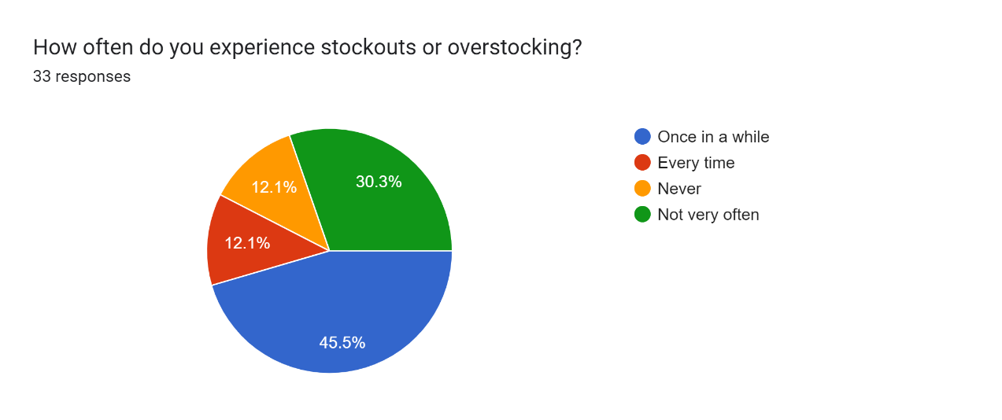
Empathy Mapping Using Survey: Analyzing Feed Back From Google Form
Forms response chart. Question title: What is your role in your organization?. Number of responses: 33 responses.
42.4% from this response are the business owners, meaning you're certain of more accurate answer, because they are directly affected.
Forms response chart. Question title: How do you currently manage your inventory?. Number of responses: 33 responses.
From this response, a larger percent of the people still engage in manual inventory counting, 27.3% still using spreadsheet, hence the need for an InventoryMax app
Forms response chart. Question title: How often do you experience stockouts or overstocking?. Number of responses: 33 responses.
From this response, only 12.1% never experience stockouts or overstocking, while 87.9 have a history of overstocking or stockouts, resulting in lost sales and revenue and overstocking resulting to holding excess stock, tying up capital and increasing storage costs, hence the need for InventoryMax app

Slide 12

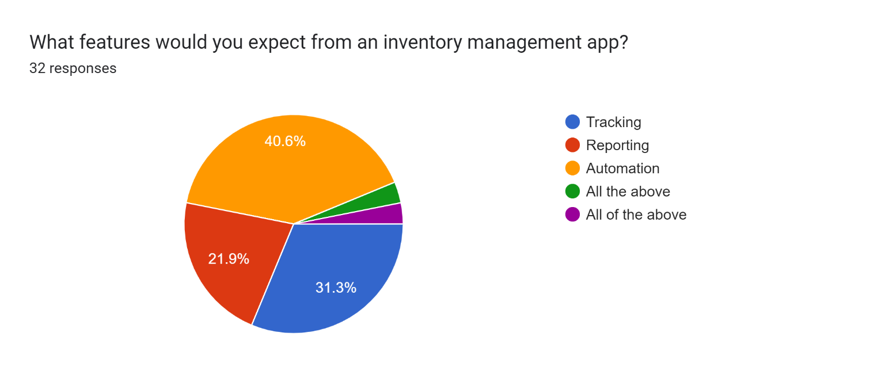
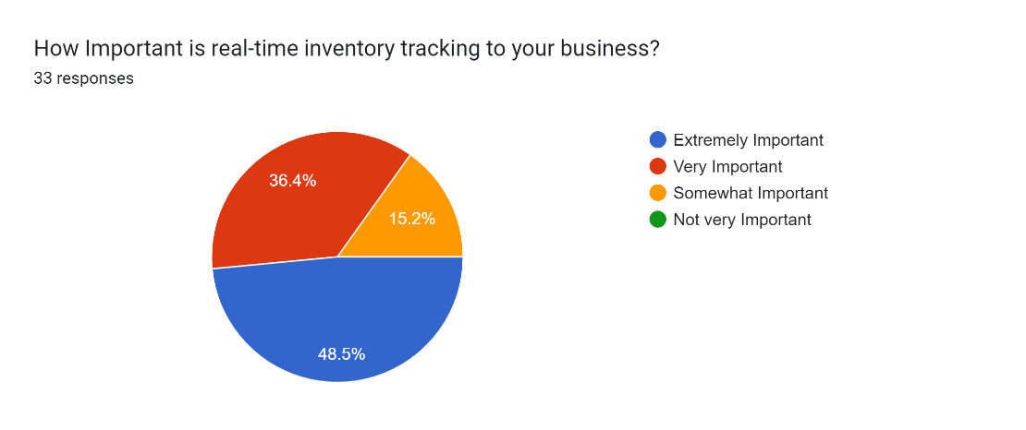
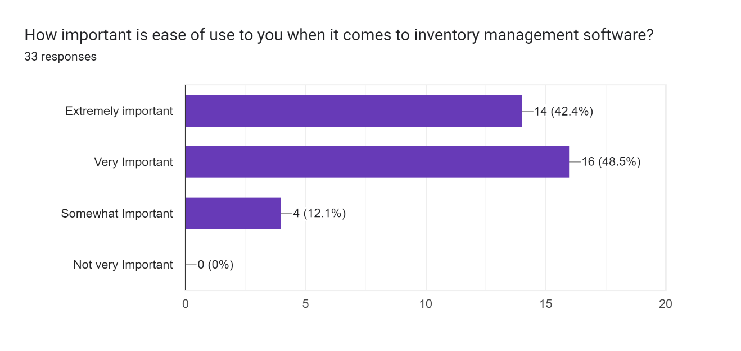
Empathy Mapping Using Survey: Analyzing Feed Back From Google Form
Forms response chart. Question title: What features would you expect from an inventory management app?. Number of responses: 32 responses.
Tracking, automation and reporting are key features of an inventory management app
Forms response chart. Question title: How Important is real-time inventory tracking to your business?. Number of responses: 33 responses.
84.9%, which is above average, strongly accept that a real-time inventory tracking is extremely important to any business
Forms response chart. Question title: How important is ease of use to you when it comes to inventory management software?. Number of responses: 33 responses.
Again 90.9% agrees that they need an inventory management app that is easy to use making it easy to manage stock, so they can make informed decisions and improve their bottom line.

Slide 13


CREATING PERSONAS BASED ON RESEARCH
Derek
ABOUT THE USER
DEMOGRAPHIC INFORMATION
MOODS AND PERSONALITY
Derek is an Operations Manager with 8 years of experience in the electronics industry. He's responsible for managing online sales, inventory, and customer experience. He is passionate about staying ahead of the competition. He values data-driven decision-making.
.
Age: 40
Occupation: Operations Manager
Industry: Electronics
Location: Benin City, Edo
(Friendly, disciplined, strong)
FRUSTRATIONS
GOALS AND NEEDS
Inaccurate inventory levels leading to stockouts and overselling.
Inventory complexity
Customer complaint of non-availability of certain products because of stockouts
Increase online sales by 20% within the next quarter.
Improve supply chain efficiency to reduce shipping times.
Stay competitive in the industry
QUOTE
"I want to make our online store the go-to destination for electronics enthusiasts. We need to stay ahead of the competition and make sure our customers find what they're looking for quickly and easily."

Slide 14

CREATING PERSONAS BASED ON RESEARCH
Emily
ABOUT THE USER
DEMOGRAPHIC INFORMATION
MOODS AND PERSONALITY
Emily is a fashion designer who is looking for a solution to her inventory twist
Age: 34
Occupation: Owner, Small Retail Business (Fashion)
Location: Ikeja Lagos
Helpful
Independent
Resourceful
FRUSTRATIONS
GOALS AND NEEDS
I spend too much time manually counting inventory and reconciling discrepancies."
"I'm frustrated with the lack of automation in our current inventory management system."
Efficiently manage inventory to avoid stockouts and overstocking
Improve accuracy and visibility into stock levels
QUOTE
"I want to focus on growing my business, not getting bogged down in manual inventory tracking. I need a solution that makes it easy to manage my stock, so I can make informed decisions and improve my bottom line."

Slide 15

PROBLEM STATEMENT
Small-scale businesses in Nigeria struggle with inefficient inventory management, leading to:
Stockouts: Running out of stock, resulting in lost sales and revenue
Overstocking: Holding excess stock, tying up capital and increasing storage costs
Manual errors: Inaccurate tracking and reporting due to manual processes, leading to stock discrepancies and waste
Lack of visibility: Insufficient real-time insights into stock levels, making it difficult to make informed decisions
Inefficient operations: Wasting time and resources on manual inventory management, taking away from core business activities
These challenges result in:
Reduced profitability
Decreased customer satisfaction
Increased stress and workload for business owners
A user-friendly, automated, and data-driven inventory management solution is needed to address these challenges and empower small-scale businesses in Nigeria to optimize their inventory management, streamline operations, and drive growth."

Slide 16
PRODUCT REQUIREMENT DOCUMENT (PRD)
PRODUCT NAME: InventoryMax
OVERVIEW:
InventoryMax is a cloud-based inventory management software designed to help small to medium-sized businesses (SMBs) efficiently manage their inventory levels, track stock movements, and optimize supply chain operations.
Goals and Objectives:
1. Improve inventory accuracy and visibility
2. Reduce stockouts and overstocking
3. Enhance operational efficiency and productivity
4. Provide real-time data for informed decision-making
5. Integrate with existing e-commerce platforms and accounting software
PROBLEM STATEMENT
Small-scale businesses in Nigeria face several challenges. They struggle with inefficient inventory management, leading to:
Stockouts: Running out of stock, resulting in lost sales and revenue
Overstocking: Holding excess stock, tying up capital and increasing storage costs
Manual errors: Inaccurate tracking and reporting due to manual processes, leading to stock discrepancies and waste
Lack of visibility: Insufficient real-time insights into stock levels, making it difficult to make informed decisions
Inefficient operations: Wasting time and resources on manual inventory management, taking away from core business activities

Slide 17
PRD
These challenges result in:
Reduced profitability
Decreased customer satisfaction
Increased stress and workload for business owners
Hence a user-friendly, automated, and data-driven inventory management solution is needed to address these challenges and empower small-scale businesses in Nigeria to optimize their inventory management, streamline operations, and drive growth."
SOLUTION STATEMENT
Introducing "InventoryMax" - a cloud-based app designed to streamline and optimize inventory tracking for small-medium businesses (SMBs) will help achieve
1. Accurate real-time inventory tracking
2. Automated low-stock alerts and reporting
3. Efficient ordering and restocking processes
4. Enhanced visibility across multiple locations
5. Reduced labor costs and increased productivity
6. Improved customer satisfaction

Slide 18
PRD
CORE FEATURES:
1. Barcode scanning and RFID integration i.e (Radio Frequency Identification) this will enable automatic identification and tracking of objects.
2. Multi-location inventory management
3. Automated reporting and analytics
4. Low-stock alerts and notifications
5. Order management and tracking
6. Integration with e-commerce platforms and accounting software
FUNCTIONAL REQUIREMENTS:
User Management: Key Features
1. User registration and login
2. Role-based access control (admin, manager, user)
3. Password reset and recovery
INVENTORY MANAGEMENT:
1. Product creation and editing
2. Inventory tracking (quantity, location, status)
3. Low-stock alerts and notifications
4. Barcode scanning and RFID integration
5. Inventory reporting and analytics

Slide 19
PRD
NON-FUNCTIONAL REQUIREMENTS:
1. Performance: 99.9% uptime
2. Security: SSL encryption, secure data storage
3. Usability: intuitive UI, user-friendly navigation
4. Scalability: support for 100+ users, 10,000+ SKUs
USER INTERFACE (UI) REQUIREMENTS:
1. Responsive design for desktop, tablet, mobile
2. Clear and concise labeling and instructions
3. Prominent display of key metrics and alerts
4. Customizable dashboard and reporting
TECHNICAL REQUIREMENTS:
1. Cloud-based infrastructure (AWS, Azure)
2. Database management system (MySQL, PostgreSQL)
3. Programming languages (JavaScript, Python)
4. API integration for third-party services
ORDER MANAGEMENT:
1. Order creation and management
2. Order tracking and status updates
3. Automated inventory updates
4. Integration with e-commerce platforms
SUPPLY CHAIN MANAGEMENT:
1. Supplier management (contact info, pricing)
2. Purchase order creation and management
3. Shipping and receiving management
4. Automated inventory updates
REPORTING AND ANALYTICS:
1. Inventory levels and valuation
2. Order history and trends
3. Suppli2. Accounting software (QuickBooks, Xero)
3. Barcode scanners and RFID devices

Slide 20
PRD
TARGET AUDIENCE:
- Small to medium-sized businesses (SMBs)
- Retail and e-commerce companies
- Wholesale and distribution businesses
- Manufacturing and production companies
KEY DIFFERENTIATORS:
1. User-friendly interface
2. Scalable and flexible architecture
3. Advanced reporting and analytics
4. Seamless integration with existing systems
5. Competitive pricing and exceptional support

Slide 21



PRODUCT DEVELOPMENT ROADMAP
PRD
1
4
5
8
Phase 1 (0-3 months)
Testing and Quality Assurance:
2
Launch and Deployment
Assumptions & Dependencies:
. 1. User management and authentication
2. Inventory management and tracking
3. Basic reporting and analytics
3
6
7
Phase 2 (4-6 months)
Phase 3 (7-9 months)
1. Unit testing and integration testing
2. User acceptance testing (UAT)
3. Security testing and penetration testing
1. Cloud-based deployment (AWS, Azure)
2. Automated backups and updates
3. Documentation and user support
Maintenance and Support:
Success Metrics
1. Reliable internet connectivity
2. Compatible hardware and software
3. Accurate and timely data input
1. Integration with e-commerce platforms
2. Barcode scanning and RFID integration
3. Customizable dashboard and reporting
1.Regular software updates
2. Priority customer support
3. Continuous monitoring and optimization
1. User adoption and retention
2. Inventory accuracy and reduction in stockouts
3. Operational efficiency and productivity gains
4. Customer satisfaction and feedback
1. Order management and integration
2. Supply chain management
3. Advanced reporting and analytics

Slide 22
COMPETITIVE ANALYSIS
InventoryMax Competitors are: Zoho Inventory, TradeGecko, Skubana, Cin7, and Lightspeed.
Competitors | Strength | Weakness
Zoho Inventory | -Affordable Pricing - User friendly interface | -Limited customization options - Limited scalability for large enterprises
TradeGecko | -Robust inventory management features - Integration with multiple e-commerce platforms - Strong customer support | - Steeper learning curve - Higher pricing tier
Skubana | - Advanced automation capabilities - Integration with multiple sales channels - Strong analytics | - Higher pricing tier - Limited international support
Cin7 | - Integrated with multiple e-commerce platforms - Robust reporting and analytics - Scalable for large enterprises | - Higher pricing tier - Complex setup process
Lightspeed | - Integrated POS and e-commerce solutions - Robust inventory management features - Strong customer support | - Higher pricing tier - Limited scalability for small businesses
InventoryMax | - User-friendly interface - Affordable pricing - Advanced RFID integration | - Limited customization options - Limited international support

Slide 23

SWOT ANALYSIS FOR INVENTORYMAX
STRENGTHS:
Internal factors
Weaknesses:
Internal Factor
Automation:
Real-time Tracking:
Integration
Initial Setup & Maintenance Cost
Technical Issues
Complexity in staff Training/Learning Curve
Data-driven decision-making
Scalability
Cost savings
Integration challenges
Customization Limits
Dependency on Technology
Opportunities: External Factor
Threats:
External Factor
Growing E-commerce
Technological Advancement
Partnerships
Competition
Regulatory
Changes
Cybersecurity Risks
Global Expansion
Growing demand for automation
Economic Downturns
Changing Market Trends

Slide 24
A CONCISE OVERVIEW OF INVENTORYMAX COMPETITIVE LANDSCAPE USING PORTER’S 5 FORCES
Rivalry Among Existing Competitors
Competitive rivalry among existing competitors to an inventory management product is high. Here's why:
The inventory management software market is highly competitive, with many established players and new entrants: This intense competition leads to:
Aggressive marketing and sales tactics
Continuous product improvement
Pricing pressure
High customer acquisition and retention costs
Force | Score (High/Medium/Low)
Threat of New Entrants | Medium – (4/10)
Bargaining Power of Suppliers | Low – (2/10)
Bargaining Power of Buyers | Medium – (5/10)
Threat of Substitute Products | Low – (3/10)
Competitive Rivalry | High – (8/10)
Threat of New Entry
The threat of new entrants to an InventoryMax is medium. Here's why:
High barriers to entry:
Moderate barriers to entry:
Low barriers to entry:
Bargaining Power of Suppliers
The bargaining power of suppliers to an inventory management product is low. Here's why:
Inventory management software typically relies on standard technologies and infrastructure (e.g., servers, databases, programming languages).
Suppliers of these technologies (e.g., Amazon Web Services, Microsoft) have limited bargaining power.
Competitive
Rivalry
Bargaining Power of Buyers
Threat of Substitutes Products
The bargaining power of buyers to an inventory management product is medium. Here's why:
Buyers (businesses using inventory management software) have some bargaining power due to:
Moderate switching costs (time, money, and effort required to change software)
Availability of alternative solutions (competitors, open-source options)
Some buyers may have significant purchasing power (large enterprises)
Alternative software may not offer the same features, quality, or support
Threat of substitute product or service to an inventory management product is low. Here's why:
Substitute products (manual inventory management, spreadsheets, or alternative software) are available but have limitations:
Manual methods are time-consuming, error-prone, and difficult to scale
Spreadsheets have limitations in terms of automation, integration, and collaboration
Alternative software may not offer the same features, quality, or support
SUMMARY
This concise overview helps to understand the competitive landscape and ultimately help to make informed strategic decisions.

Slide 25
IN SUMMARY
InventoryMax is to compete with established players in the inventory management market, hence the need to put measures in place to sets it apart from its competitors.
Competitors Strength
Integration with Zoho CRM and other Zoho apps, affordable
Robust inventory management features, strong customer support
Advanced automation capabilities, strong analytics
Integrated with multiple e-commerce platforms, robust reporting
Integrated POS and e-commerce solutions, strong customer support
Risks Posed by Competitors:
1. Market share: Established competitors have existing customer bases.
2. Feature competition: Competitors offer robust feature sets.
3. Pricing pressure: Competitors may undercut InventoryMax's pricing.
4.Partnerships: Competitors may establish exclusive partnerships with key players.
InventoryMax Mitigation Strategies
Competition: Differentiate through unique features (RFID integration, user-friendly interface).
Focus on small to medium-sized businesses.
Develop strategic partnerships with e-commerce platforms and accounting software providers.
Offer competitive pricing and flexible plans.
Invest in excellent customer support
Competitive Advantage: InventoryMax's unique combination of advanced RFID integration, user-friendly interface, and customizable reporting sets it apart from competitors.
Competitor Monitoring: Regularly track competitor’s
Pricing and plans
Feature updates
Marketing strategies
Partnerships and collaborations
Customer reviews and feedback
By understanding competitors' strengths, weaknesses, and strategies, InventoryMax can effectively differentiate itself and mitigate risks in the market.

Slide 26

THREE POTENTIAL COLLABORATORS FOR THE PRODUCT INVENTORY MANAGEMENT, ALONG WITH THE RATIONALE AND ANTICIPATED IMPACT
Collaborator 1: Shopify
Rationale: Shopify is a leading e-commerce platform with a vast user base of small to medium-sized businesses. Integrating Inventory Management with Shopify can expand its reach and provide a comprehensive solution for online retailers.
Anticipated Impact:
Increased user base and market share
Enhanced e-commerce capabilities
Streamlined inventory management for online retailers
Potential for co-marketing and cross-selling opportunities
Collaborator 2: QuickBooks
Rationale: QuickBooks is a popular accounting software used by many small businesses. Integrating Inventory Management with QuickBooks can provide a seamless financial management experience and enhance the overall value proposition.
Anticipated Impact:
Improved financial management capabilities
Enhanced accuracy and automation of financial data
Increased customer satisfaction and retention
Potential for co-marketing and cross-selling opportunities
Collaborator 3: FedEx/UPS
Rationale: FedEx and UPS are leading logistics providers that can enhance the inventory management experience by providing real-time shipping and tracking capabilities.
Anticipated Impact:
Improved shipping and logistics management
Enhanced supply chain visibility
Increased efficiency and reduced costs
Potential for co-marketing and cross-selling opportunities
In each collaboration, the anticipated impact includes increased user base, enhanced capabilities, improved customer satisfaction, and potential co-marketing opportunities. These collaborations can help Inventory Management expand its reach, improve its value proposition, and drive business growth.

Slide 27


ANALYZING MARKET TRENDS AND GROWTH OPPORTUNITIES
Understanding current market trends is essential to help InventoryMax stay ahead of the curve and identify emerging opportunities. With it, InventoryMax can:
Develop innovative solutions addressing emerging trends
Enhance its competitive advantage
Expand into new markets and industries
Improve customer satisfaction and retention
Stay compliant with regulatory requirements
Technology Trends:
1. Inventory management: A shift to cloud-based solutions and automation
2. Artificial Intelligence (AI) and Machine Learning (ML) for predictive analytics
3. Internet of Things (IoT) for real-time inventory tracking
4. Mobile-first and mobile-only strategies
5. Blockchain for supply chain transparency
6. Automation and robotics in warehouses
7. Big Data and data analytics for insights
Consumer Behavior Trends:
1. There is an increase in demand for same-day or next-day delivery
2. Expectations for real-time inventory availability
3. Growing importance of omnichannel shopping experiences
4. Rising demand for personalized products and services
5. Shift towards sustainable and eco-friendly products
6. Increased online shopping and e-commerce adoption
7. Desire for seamless returns and exchanges
Industry Trends:
1. E-commerce growth and expansion
2. Rise of direct-to-consumer (DTC) brands
3. Increased focus on supply chain optimization
4. Growing importance of inventory accuracy and visibility
5. Adoption of dropshipping and third-party logistics (3PL)
6. Shift towards just-in-time (JIT) inventory management
7. Integration of inventory management with ERP systems (Enterprise Resource Planning) systems. They are integrated software solutions that manage and automate core business processes. This helps to provide real-time visibility and control across an organization.
Regulatory Trends:
1. Compliance with GDPR and data protection regulations
2. Adherence to tax and tariff regulations
3. Compliance with environmental and sustainability regulations
4. Regulations around product labeling and packaging
5. Increased scrutiny of supply chain ethics and labor practices
6. Compliance with industry-specific regulations (e.g., healthcare, aerospace)
7. Evolving regulations around e-commerce and online marketplaces
Market Opportunities:
1. Expanding into new e-commerce platforms and marketplaces
2. Integrating with emerging technologies (e.g., AR, VR)
3. Developing AI-powered inventory forecasting tools
4. Offering sustainable and eco-friendly inventory solutions
5. Providing real-time inventory visibility for omnichannel shopping
6. Partnering with 3PL providers for expanded logistics capabilities
7. Developing industry-specific inventory management solutions
Market Challenges:
1. Competition from established inventory management players
2. Integration challenges with existing systems and infrastructure
3. Ensuring data security and compliance with regulations
4. Managing complex global supply chains
5. Adapting to changing consumer behaviors and expectations
6. Balancing inventory levels with fluctuating demand
7. Managing costs and scalability
InventoryMax Competitive Advantage:
1. AI-powered predictive analytics
2. Real-time inventory visibility
3. Seamless integration with e-commerce platforms
4. Automated inventory tracking and reporting
5. Customizable dashboards and alerts
6. Scalable and flexible architecture
7. Expert customer support and training
This analysis provides a comprehensive overview of market trends, opportunities, and challenges for InventoryMax, enabling informed strategic decisions.

Slide 28

GROWTH OPPORTUNITIES
Growth Opportunities:
1. Artificial Intelligence (AI) and Machine Learning (ML) integration.
2. Internet of Things (IoT) adoption in inventory management.
3. Blockchain for supply chain transparency and security.
4. Mobile commerce and social commerce expansion.
5. Sustainability-focused products and services.
Emerging Markets:
Global inventory management growth in market size
Industry-Specific Opportunities:
1. Healthcare: Medical supply chain management
2. Retail: Omnichannel inventory management
3. Manufacturing: Predictive maintenance and quality control
4. Food and Beverage: Cold chain management
Technological Advancements:
1. Cloud-based inventory management
2. Mobile apps for inventory tracking
3. AI-powered inventory forecasting
4. RFID and IoT for real-time tracking
5. Blockchain for supply chain transparency
Challenges and Barriers:
1. Integration with existing systems
2. Data security and privacy concerns
3. Scalability and flexibility
4. User adoption and training
5. Competition from established players
Market Analysis Tools:
1. SWOT analysis
2. Porter's Five Forces
3. Market segmentation
4. Competitive analysis
5. Trend analysis

Slide 29
This is the reason why a customer should believe in your product or service. It is the promise you make to customers on how you intend to meet their identified needs
Value Preposition for InventoryMax:
Using the 4C’s Frame Work
Competitors
Customers
Value Preposition
Company
Collaborators
Collaboration:
Seamless integration with existing ERP, CRM, and accounting systems.
Partnerships with industry experts for tailored solutions.
Dedicated customer support and training.
Company:
Leveraging expertise in supply chain optimization and inventory innovation.
Continuous investment in R&D for cutting-edge solutions.
Proven track record of successful implementations.
Competitors:
- Unlike manual methods or basic inventory tools, InventoryMax offers advanced features and real-time tracking.
- Outperforms competitors in automation, reporting, and scalability.
Customers:
Simplify inventory management with easy-to-use interfaces and mobile accessibility.
Reduce stockouts, overstocking, and associated costs by up to 30%.
Enhance decision-making with data-driven insights.
Value Proposition Statement:
"InventoryMax empowers businesses to optimize inventory management, reduce costs, and boost efficiency through advanced automation, real-time tracking, and data-driven insights, backed by expert support and seamless integration capabilities."

Slide 30

InventoryMax Core Value Proposition:
A.THE SOLUTION IT PROVIDES:
1. Real-time Inventory Visibility: Accurate, up-to-the-minute inventory tracking across multiple locations.
2. Automated Tracking: Eliminate manual errors and streamline inventory management with barcode scanning and RFID integration. (Radio Frequency Identification) integration is the process of incorporating RFID technology into a system or application to enable automatic identification and tracking of objects, people, or assets.
The integration of RFID Benefits is numerous and they include:
Automated inventory tracking
Real-time locationing
Improved asset management
Enhanced supply chain visibility
Reduced errors and labor costs
Increased security and loss prevention
3. Intelligent Reporting: Make data-driven decisions with customizable reports and analytics.
4. Seamless Integration: Connect with popular e-commerce platforms, accounting software, and other business apps.
B. UNIQUE SELLING POINTS (USP) AND COMPETITIVE ADVANTAGE:
1. RFID Integration: Advanced inventory tracking capabilities for improved accuracy.
2. User-Friendly Interface: Intuitive design for easy adoption and minimal training.
3. Customizable Reporting: Tailor reports to your business needs for informed decision-making.
4. Streamlines inventory Management for small to medium-sized businesses
C. THE KEY BENEFITS:
Reduce Stockouts and Overstocking
Increase Efficiency
Improve Accuracy
Enhance Customer Satisfaction
Streamlined operations
Reduced inventory costs
Enhanced decision-making
Scalable and flexible
Expert support and training
D. PAIN POINTS ADDRESSED
1. Inaccurate inventory tracking
2. Manual inventory management
3. Stockouts and overstocking
4. Lack of real-time visibility
5. Limited scalability
Elevator Pitch:
"Transform your inventory management with InventoryMax. Say goodbye to stockouts, overstocking, and manual errors. Our advanced app simplifies tracking, automates reporting, and provides data-driven insights, ensuring your business runs smoothly and efficiently."

Slide 31
CUSTOMER STRATEGY (STP)
Segmentation
Targeting
Segmenting the market can help identify customer groups with distinct needs, allowing for tailored messaging and value propositions:
InventoryMax Segmentation using the MAADS framework
MAADS stands for:
1. Market: Small to medium-sized businesses (SMBs), retailers, wholesalers, and distributors.
2. Application: Inventory management, supply chain optimization.
3. Attribute: Companies with 10-500 employees, $1M-$50M revenue.
4. Demographics: Decision-makers: operations managers, logistics managers, business owners.
5. Satisfaction: Businesses seeking efficient inventory tracking, automated reporting.
Customer Segmentation:
Industry:
1. Fashion and apparel 2. Electronics 3. Home goods and furniture
4. Food and beverage 5. Health and beauty
Business Size:
1.Micro (1-10 employees)
2. Small (11-50 employees)
3. Medium (51-100 employees)
with basic Pain Points of
Inventory management inefficiencies
Stockouts/overstocking
Lack of real-time visibility
Manual tracking errors
Segments to serve with specific product
Positioning
The wants of each set of similar customer
How you want to be perceived by customers
Target Market
InventoryMax Primary Target Audience:
1. Small to medium-sized businesses (SMBs) in the retail and e-commerce industries
2. Businesses with 1-50 employees
3. Annual revenue between ₦500,000 and ₦10 million
Specific Industries:
1. Fashion and apparel 2. Electronics 3. Home goods and furniture
4. Food and beverage 5. Health and beauty
Decision-Maker Profile:
1. Owners or founders of SMBs 2. Operations managers
3. Inventory managers 4. Logistics coordinators 5. E-commerce managers
Key Characteristics:
1. Growing businesses seeking to streamline inventory management
2. Companies experiencing inventory management pain points (stockouts, overstocking, etc.)
3. Businesses seeking cloud-based, user-friendly inventory management solutions
4. Organizations willing to invest in technology to improve operational efficiency
Secondary Target Audience:
1. Wholesale and distribution businesses (2) Manufacturing companies with inventory management needs
3. Businesses in other industries with similar inventory management challenges
InventoryMax has a single-sided market, as the primary customers are businesses seeking inventory management solutions.

Slide 32


USER PERSONA
Persona 1: Ana
- Age: 28
- Industry: Health Care
- Business size: Small (20 employees)
- Job function: Pharmaceutical Distributor
- Pain points: Inventory management inefficiencies, stockouts
- Goals: Streamline inventory management, reduce errors
Persona 2: David
- Age: 30
- Industry: Manufacturing and Logistics
- Business size: Medium (50 employees)
- Job function: Supply Chain Manager
- Pain points: Lack of real-time visibility, manual tracking errors
- Goals: Improve inventory accuracy, enhance customer satisfaction

Slide 33
USER STORY
As an e-commerce store owner, I want to easily manage my inventory across multiple warehouses and online marketplaces, so I can prevent stockouts, reduce overstocking, and improve customer satisfaction.
MVP Features:
Core Features:
1. Inventory Tracking: Real-time tracking of inventory levels across multiple warehouses.
2. Multi-Warehouse Management: Manage inventory across multiple warehouses.
3. Product Management: Create and manage products with descriptions, images, and pricing.
4. Order Management: Integrate with e-commerce platforms to track orders and updates.
5. Reporting and Analytics: Basic reporting and analytics for inventory levels, sales, and stockouts.
Integration Features:
1. E-commerce Platform Integration: Integrate with popular e-commerce platforms (Shopify, WooCommerce, BigCommerce).
2. Accounting Software Integration: Integrate with accounting software (QuickBooks, Xero).
User Interface Features:
1. User-Friendly Dashboard: Clear and intuitive dashboard for InventoryMax
2. Customizable Alerts: Set up alerts for low inventory, stockouts, and overstocking.
MVP Requirements:
1. Support for 3 users
2. 100 SKUs (Stock Keeping Units)
3. Integration with 2 e-commerce platforms
4. 1-hour data synchronization
MVP Benefits:
1. Reduce stockouts by 50%
2. Decrease overstocking by 30%
3. Improve inventory accuracy by 90%
4. Increase customer satisfaction by 25%
MVP Development Timeline:
1. Research and planning: 2 weeks
2. Development: 12 weeks
3. Testing and QA: 4 weeks
4. Launch: 2 weeks
MVP Development Team:
1. 2 developers
2. 1 QA engineer
3. 1 designer
4. 1 project manager
This MVP will provide a solid foundation for InventoryMax, allowing users to manage inventory, integrate with e-commerce platforms, and gain insights into their operations.
Next Steps:
1. Refine MVP features based on user feedback.
2. Develop additional features and integrations.
3. Scale and optimize InventoryMax for larger user base.

Slide 34
Positioning
InventoryMax can use three positioning approaches:
1. Rational/Functional Approach
Positioning Statement: "Effortlessly manage your inventory with InventoryMax's advanced tracking and automation capabilities, reducing stockouts and overstocking by up to 30%.“
Key Messages:
- Real-time inventory tracking
- Automated reporting and alerts
- Optimized stock levels
2. Emotional Approach
Positioning Statement: "Take control of your inventory and peace of mind with InventoryMax, your trusted partner for streamlined operations."
Key Messages:
- Reduce stress with reliable inventory management
- Focus on growth, not inventory worries
- Expert support when you need it
3. Cultural Approach
Positioning Statement: "Join the InventoryMax community, empowering businesses like yours to thrive through efficient inventory management and innovation."
Key Messages:
- Industry-leading expertise
- Community support and resources
- Forward-thinking solutions
By using these STP strategies, InventoryMax can effectively reach and resonate with its target audience, differentiating itself in the market.

Slide 35
InventoryMax Business Model Canvas
KEY PARTNERS
KEY ACTIVITIES
VALUE PROPOSITIONS
CUSTOMER RELATIONSHIPS
CUSTOMER SEGMENTS
E-commerce platforms (Shopify, WooCommerce)
Accounting software providers (QuickBooks, Xero)
Supply chain management companies
Logistics providers (UPS, FedEx)
Industry associations and organizations
Software development and maintenance
Integration with e-commerce platforms and accounting software
Data analytics and reporting
Customer support and training
Marketing and sales
Real-time inventory tracking and management
Automated reporting and analytics
Improved supply chain efficiency
Enhanced customer satisfaction
Scalable and customizable solution
Personalized support and training
Regular software updates and enhancements
Dedicated account management
Online community and forums
Priority support for premium customers
E-commerce businesses
Small to medium-sized businesses (SMBs)
Retail and wholesale industries
Manufacturing and distribution companies
Industry-specific businesses (healthcare, aerospace)
KEY RESOURCES
CHANNELS
Development team
Sales and marketing team
Customer support team
Data centers and infrastructure
Partnerships with e-commerce platforms and accounting software providers
Online sales and marketing
Partnerships with e-commerce platforms and accounting software providers
Referral programs and word-of-mouth
Trade shows and industry events
Digital marketing (SEO, PPC, email)
COST STRUCTURE
Development and maintenance costs
Marketing and sales expenses
Customer support and training costs
Infrastructure and data center costs
Partnership and integration fees
REVENUE STREAMS
Subscription-based model (monthly/yearly)
Premium features and add-ons
Integration fees with e-commerce platforms and accounting software
Consulting and implementation services
Advertising and sponsored content

Slide 36
EXPLANATION OF EACH SECTION OF THE BUSINESS MODEL CANVAS:
Key Partners
These are the organizations that InventoryMax collaborates with to deliver its value proposition:
Key Activities
These are the main operations that InventoryMax performs to deliver its value proposition:
Key Resources
These are the essential assets that InventoryMax requires to operate:
Value Proposition
This is the unique benefit that InventoryMax offers to its customers:
Customer Relationships
These are the interactions that InventoryMax has with its customers:
Distribution Channels
These are the platforms that InventoryMax uses to reach its customers:
Customer Segmentation
These are the target markets that InventoryMax serves:
Cost Structure
These are the expenses that InventoryMax incurs:
Revenue Streams
These are the sources of income for InventoryMax:

Slide 37
PRIORITIZATION PRIORITIZING INVENTORYMAX FEATURES USING THE MoSCow FRAMWORK
MOSCOW stands for Must-Haves, Should-Haves, Could-Haves, and Won't-Haves. It categorizes features based on their necessity, priority, feasibility, and potential impact.
Benefits of Using MOSCOW
1. Clear prioritization
2. Alignment with business goals
3. Effective resource allocation
4. Improved stakeholder communication
5. Enhanced product roadmap
Must-Haves
Should-Haves
Could-Haves
Won’t-Haves
1. Automated Inventory Tracking
2. Real-time Reporting
3. User Authentication and Authorization
1. Integration with E-commerce Platforms
2. Mobile Optimization
3. Customizable Dashboards
1. Predictive Analytics
2. AI-powered Inventory Forecasting
3. Automated Stock Replenishment
1. Support for Legacy Systems
2. Custom Integration with ERP Systems
Prioritized Features (MOSCOW)
1. Must-Haves (critical features) 2. Should-Haves (important but not critical)
3. Could-Haves (nice-to-have features) 4. Won't-have (don’t add enough value)

Slide 38

CATEGORIZATION OF STAKEHOLDERS
Internal Stakeholders
1. Founders/Owners
2. CEO/Managing Director
3. Operations Manager
4. Logistics Manager
5. IT Manager
6. Sales Team
7. Customer Support Team
8. Developers/Engineers
External Stakeholders
1. Customers (E-commerce store owners)
2. Suppliers/Manufacturers
3. Partners/Integrators (E-commerce platforms, accounting software)
4. Investors/Venture Capitalists
5. Industry Analysts/Researchers
6. Competitors
7. Regulatory Bodies (Government agencies)
Key Influencers
1. Industry thought leaders
2. Social media influencers
3. Reviewers/ Bloggers
4. Analysts/Researchers
Stakeholder Matrix
Stakeholder | Interest | Influence | Expectations
Customers | High | High | Effective inventory management
Founders/ Owners | High | High | Business growth, profitability
Operations Manager | Medium | Medium | Smooth operations
Logistics Manager | Medium | Medium | Efficient supply chain
Sales Team | Medium | Medium | Sales growth
Primary Stakeholders
1. Customers (E-commerce store owners)
2. Founders/Owners
3. Operations Manager
4. Logistics Manager
5. Sales Team
Secondary Stakeholders
1. Suppliers/Manufacturers
2. Partners/Integrators
3. Investors/Venture Capitalists
4. Industry Analysts/Researchers
The importance of stakeholder categorization
1. Prioritize features and development
2. Align business goals with stakeholder expectations
3. Improve communication and relationships
4. Manage conflicts and competing interests
5. Ensure successful product launch and adoption
This categorization helps identify and prioritize stakeholders' needs, interests, and expectations.

Slide 39


PRODUCT METRICS FOR INVENTORYMAX
USER ORIENTED PRODUCT METRICS
1. User Engagement:
Daily Active Users (DAU)
Weekly Active Users (WAU)
Monthly Active Users (MAU)
2. User Satisfaction:
Net Promoter Score (NPS)
Customer Satisfaction (CSAT)
User Reviews and Ratings
3. User Retention:
User Retention Rate
Average Session Length
Bounce Rate
4. User Experience:
Time to Resolve Issues
Error Rate
User Feedback and Support Tickets
5. Adoption and Onboarding:
Time to First Use
Onboarding Completion Rate
Feature Adoption Rate
BUSINESS-ORIENTED PRODUCT METRICS
1. Revenue Growth:
Monthly Recurring Revenue (MRR)
Annual Recurring Revenue (ARR)
Revenue Growth Rate
2. Customer Acquisition
Customer Acquisition Cost (CAC)
Customer Lifetime Value (CLV)
Return on Investment (ROI)
3. Customer Retention:
Customer Churn Rate
Customer Retention Rate
Average Revenue Per User (ARPU)
4. Operational Efficiency:
Inventory Turnover Rate
Supply Chain Efficiency
Order Fulfillment Rate
5. Market Share and Competition:
Market Share
Competitive Landscape
Customer Satisfaction vs. Competitors

Slide 40
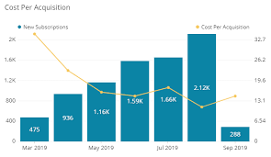

Specific Metrics and Calculations for InventoryMax
1. Inventory Accuracy
Calculation: Percentage of accurate inventory records, including quantity, location, and condition.
Benchmark: 95% - 98%
2. Order Fulfillment Rate
Calculation: Percentage of orders fulfilled without delays or stockouts.
Benchmark: 99% - 100%
3. Stockout Frequency
Calculation: Number of stockouts per period (e.g., month, quarter).
Benchmark: < 2% of total orders
4. Overstocking Frequency
Calculation: Number of overstocking instances per period.
Benchmark: < 5% of total inventory
5. Supply Chain Lead Time
Calculation: Time from ordering to receipt of goods.
Benchmark: < 3 days
6. Customer Satisfaction with Inventory Management
Calculation: Measured through surveys or feedback.
Benchmark: > 85% satisfied customers
7. User Engagement with Inventory Reports
Calculation: Tracking usage and interaction with inventory reports.
Benchmark: > 75% monthly active users
8. Adoption Rate of Advanced Features
Calculation: Percentage of users utilizing advanced features (e.g., automation, analytics).
Benchmark: > 50% of total users
Key Performance Indicators (KPIs):
1. Inventory Accuracy 95%: Ensure accurate inventory records to prevent stockouts and overstocking.
2. Order Fulfillment Rate 99%: Maintain high order fulfillment rates to ensure customer satisfaction.
3. Customer Satisfaction (CSAT) 85%: Monitor customer satisfaction with inventory management.
4. User Retention Rate 75%: Track user retention to ensure long-term customer relationships.
5. Revenue Growth Rate 20%: Monitor revenue growth to ensure InventoryMax’s financial health.
6. Customer Acquisition Cost (CAC): Optimize customer acquisition costs to maintain profitability.
7. Customer Lifetime Value (CLV): Ensure high CLV to justify customer acquisition and retention efforts.
8. Supply Chain Lead Time 3 days: Optimize supply chain lead time to reduce delays and stockouts.
9. Inventory Turnover Ratio > 3: Monitor inventory turnover to ensure efficient inventory management.
10. Return on Investment (ROI) Track ROI to ensure InventoryMax's financial sustainability.

Slide 41

Benefits of Tracking these Metrics:
1. Improved inventory management
2. Enhanced customer satisfaction
3. Increased revenue growth
4. Reduced costs (e.g., stockouts, overstocking)
5. Better supply chain optimization
6. Data-driven decision-making
7. Competitive advantage
8. Increased user engagement and retention
Tools for Tracking these Metrics:
1. Inventory management software (e.g., TradeGecko, Zoho Inventory)
2. Analytics platforms (e.g., Google Analytics, Mixpanel)
3. Customer feedback and survey tools (e.g., SurveyMonkey, Medallia)
4. CRM software (e.g., Salesforce, HubSpot)
5. Supply chain management software (e.g., Manhattan Associates, Infor)

Slide 42
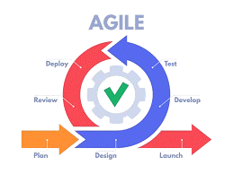
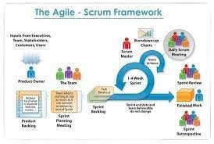
An overview of Agile Development Methodology for InventoryMax:
Agile Principles:
1. Deliver working software frequently
2. Welcome changing requirements
3. Collaborate with customers and stakeholders
4. Measure progress through working software
5. Continuous improvement
Agile Methodology for InventoryMax:
1. Define project vision and goals
2. Identify stakeholders and their roles
3. Develop initial product backlog
4. Establish Agile team and roles
5. Plan iteration schedule and milestones
Agile Manifesto Values:
1. Individuals and interactions
2. Working software
3. Customer collaboration
4. Responding to change
Sprint 5-8: Continued Development and Refining
1. Continue developing and testing features
2. Refine and iterate on existing features
3. Conduct user testing and feedback sessions
4. Address technical debt and bugs
5. Prepare for deployment
Sprint 0: Planning and Preparation
1. Prioritize product backlog items
2. Assign tasks to team members
3. Develop and test features
4. Conduct daily stand-ups and retrospectives
5. Demo working software to stakeholders
Sprint 1-4: Development Iterations
1. Prioritize product backlog items
2. Assign tasks to team members
3. Develop and test features
4. Conduct daily stand-ups and retrospectives
5. Demo working software to stakeholders

Slide 43
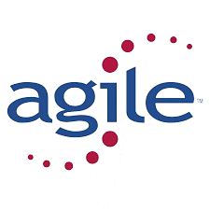
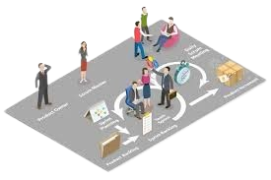
Deployment and Maintenance
1. Deploy InventoryMax to production
2. Monitor and address production issues
3. Gather customer feedback and analytics
4. Plan future iterations and enhancements
5. Continuously improve and refine the product
Agile Roles
1. Product Owner: Responsible for product vision and backlog
2. Scrum Master: Facilitates Agile process and removes impediments
3. Development Team: Develops and tests InventoryMax features
4. Stakeholders: Provide input and feedback on the product
Agile Ceremonies:
1. Daily Stand-ups: Team discusses progress and plans
2. Sprint Planning: Team plans and commits to sprint goals
3. Sprint Review: Team demos working software to stakeholders
4. Sprint Retrospective: Team reflects and improves processes
5. Backlog Refinement: Team refines and prioritizes product backlog
Agile Tools
1. Jira or Trello for project management
2. GitHub or Bitbucket for version control
3. Slack or Microsoft Teams for communication
4. Zoom or Google Meet for remote meetings
Benefits of Agile for InventoryMax
1. Faster time-to-market
2. Increased customer satisfaction
3. Improved team collaboration and communication
4. Greater flexibility and adaptability
5. Continuous improvement and refinement
Challenges and Mitigants:
1. Change management: Establish clear communication and stakeholder buy-in.
2. Team coordination: Use Agile tools and ceremonies to facilitate collaboration.
3. Prioritization: Use MoSCoW or RICE framework to prioritize features.
4. Technical debt: Schedule regular refactoring and testing.
InventoryMax development team can deliver a high-quality, customer-centric product that meets evolving business needs by adopting these Agile methodologies.

Slide 44
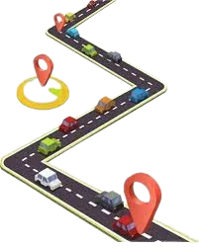





PRODUCT STRATEGY VS PRODUCT ROADMAP
Target Market Segments
1. Small to medium-sized businesses (SMBs)
2. Retail and e-commerce industries
3. Wholesale and distribution sectors
Competitive Landscape
Key competitors:
1. Zoho Inventory
2. TradeGecko
3. Skubana
4. Cin7
5. Lightspeed
Competitive advantages:
1. User-friendly interface
2. Advanced analytics and reporting
3. Seamless integrations with e-commerce platforms and accounting software
Market Trends
1. Cloud-based inventory management
2. Mobile accessibility
3. Artificial intelligence (AI) and machine learning (ML) integration
4. Internet of Things (IoT) adoption
Product Vision
To empower small-scale businesses in Nigeria to optimize their inventory management, streamline operations, and drive growth through a user-friendly, automated, and data-driven platform."
Goals and Objectives:
1. Improve inventory accuracy and visibility
2. Reduce stockouts and overstocking
3. Enhance operational efficiency and productivity
4. Provide real-time data for informed decision-making
5. Integrate with existing e-commerce platforms and accounting software
Market Overview/Analysis
The inventory management market is growing rapidly, and is driven by:
1. E-commerce growth
2. Increasing demand for real-time inventory tracking
3. Need for efficient supply chain management
PRODUCT STRATEGY: This is a high level-plan that defines the vision, goals, and objectives for a product. It focuses on the “Why” and “What” i.e. why a product exist and what it aims to achieve.
PRODDUCT ROADMAP: A strategic document showing the planned path to achieve the product strategy.

Slide 45
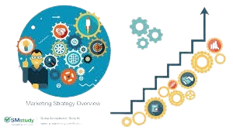
Customer Needs and Pain Points
1. Real-time inventory tracking
2. Automated reporting and analytics
3. Efficient order management
4. Seamless integrations with existing systems
5. Scalable and flexible solutions
6. Set alerts for low stock and expiration dates
7. Optimize storage and reduce waste
8. Make data-driven decisions to improve profitability
Key Performance Indicators (KPIs)
1. Customer acquisition rate
2. Customer retention rate
3. Revenue growth
4. Customer satisfaction (CSAT)
5. Net promoter score (NPS)
Go-to-Market Strategy
1. Content marketing
2. Social media campaigns
3. Influencer partnerships
4. Paid advertising (Google Ads, Facebook Ads)
5. Strategic partnerships with e-commerce platforms and accounting software providers
Pricing Strategy
Tiered pricing model
InventoryMax is well-positioned to capitalize on the growing demand for inventory management solutions.
By focusing on user-friendly design, advanced analytics, and seamless integrations, InventoryMax can differentiate itself in a competitive market and achieve significant revenue growth.

Slide 46
INVENTORYMAX PRODUCT ROADMAP
Short-Term Roadmap (Next 6-12 Months)
Teams
1st Quarter
2nd Quarter
3rd Quarter
4th Quarter
Launch InventoryMax 1.0 with core features
Establish partnerships with 5 e-commerce platforms
Software Development
Introduce customer success program
Develop API for custom integrations
Platform
Design
Release InventoryMax 2.0 with:
- AI-powered inventory forecasting
Expand customer success program to include:
- Regular business reviews
- Customized training and support
Marketing

Slide 47

PRODUCT LAUNCH AND GO-TO-MARKET STRATEGY
Product Launch:
Product Launch Definition
A product launch is the introduction of a new product or service to the market, aiming to generate buzz, drive sales, and establish a strong market presence.
Type of Launch
InventoryMax is adopting the “Breaking In” type of Launch. This is because, there are similar existing products already in place in the market. To disrupts the status quo, InventoryMax will differentiate itself from the similar existing products by:
1. Emphasizing user-friendly interface and ease of use.
2. Highlighting advanced analytics and reporting capabilities.
3. Focusing on seamless integrations with e-commerce platforms and accounting software.
4. Offering customizable dashboards and workflows and
5. Providing exceptional customer support.
Product Launch Users Checklist for InventoryMax
To ensure a successful product launch, Inventorymax will effectively differentiate itself in the market and drive user adoption by considering the following on the Product Launch User Checklist.
Pre-Launch (Weeks 1-4)
1. Finalize product development.
2. Conduct beta testing and gather feedback.
3. Establish partnerships with e-commerce platforms and accounting software providers.
4. Develop marketing materials (website, social media, content).
5. Plan launch event and promotional activities.

Slide 48

User Segments to Target
Basic areas to target are:
1. Small to medium-sized businesses (SMBs).
2. E-commerce entrepreneurs.
3. Inventory managers.
4. Supply chain professionals.
5. Accountants and bookkeepers.
Launch
1. Launch InventoryMax website and social media campaigns.
2. Send out press releases and newsletters.
3. Offer limited-time promotions or discounts.
4. Host webinars or demos.
5. Monitor and respond to customer feedback.
Post-Launch (Weeks 5-12)
1. Analyze customer feedback and iterate on product improvements.
2. Optimize marketing campaigns based on performance data.
3. Expand partnerships and integrations.
4. Develop case studies and success stories.
5. Plan future product updates and enhancements.
Launch Metrics to Track
1. Website traffic.
2. Social media engagement.
3. Customer acquisition rate.
4. Revenue growth.
5. Customer satisfaction (CSAT).

Slide 49
WHAT ARE YOU SELLING?
InventoryMax, a cloud-based inventory management software that streamlines and optimizes inventory tracking for small to medium-sized businesses. It’s a solution that offer a basic plan with the following features:
1. Real-time inventory tracking
2. Barcode scanning and RFID integration, an application that enable automatic identification and tracking of objects.
3. Automated low-stock alerts
4. multi-location inventory management
5. Basic reporting and analytics
6. Mobile accessibility
7. Integration with popular e-commerce platforms
InventoryMax solves the problems of:
1. Inaccurate inventory tracking
2. Manual inventory management
3. Stockouts and overstocking
4. Inefficient ordering and restocking
5. Lack of real-time visibility into inventory levels
TARGET MARKET
Target Market at Launch includes:
Primary Target Audience:
1. Small to medium-sized businesses (SMBs) in the retail and e-commerce industries
2. Businesses with 1-50 employees
3. Annual revenue between ₦500,000 and ₦10 million
Specific Industries:
1. Fashion and apparel 2. Electronics 3. Home goods and furniture
4. Food and beverage 5. Health and beauty
Decision-Maker Profile:
1. Owners or founders of SMBs 2. Operations managers
3. Inventory managers 4. Logistics coordinators 5. E-commerce managers
Key Characteristics:
1. Growing businesses seeking to streamline inventory management
2. Companies experiencing inventory management pain points (stockouts, overstocking, etc.)
3. Businesses seeking cloud-based, user-friendly inventory management solutions
4. Organizations willing to invest in technology to improve operational efficiency
Secondary Target Audience:
1. Wholesale and distribution businesses
2. Manufacturing companies with inventory management needs
3. Businesses in other industries with similar inventory management challenges
VALUE PREPOSITION
Core Value Proposition:
People will buy InventoryMax because of the solution it provides:
1. Real-time Inventory Visibility: Accurate, up-to-the-minute inventory tracking across multiple locations.
2. Automated Tracking: Eliminate manual errors and streamline inventory management with barcode scanning and RFID integration.
3. Intelligent Reporting: Make data-driven decisions with customizable reports and analytics.
4. Seamless Integration: Connect with popular e-commerce platforms, accounting software, and other business apps.
Because of our Unique Selling Points (USPs) and Competitive Advantage:
1. RFID Integration: Advanced inventory tracking capabilities for improved accuracy.
2. User-Friendly Interface: Intuitive design for easy adoption and minimal training.
3. Customizable Reporting: Tailor reports to your business needs for informed decision-making.
4. Streamlines inventory management for small to medium-sized businesses
Because of the Key Benefits:
1. Reduce Stockouts and Overstocking 2. Increase Efficiency 3. Improve Accuracy
4. Enhance Customer Satisfaction 5. Scale Your Business:
Because of the key pain points addressed
1. Inaccurate inventory tracking (2.) Manual inventory management
3. Stockouts and overstocking (4.) Lack of real-time visibility
5. Limited scalability
LAUNCH STRATEGY
Pre-Launch (Weeks 1-4)
1. Finalize product development
2. Conduct beta testing with select customers
3. Gather feedback and iterate on product improvements
4. Establish partnerships with e-commerce platforms and accounting software providers
5. Develop marketing materials (website, social media, content)
Launch Week (Week 5)
1. Officially launch InventoryMax
2. Send out press releases to industry publications
3. Host a webinar to showcase product features and benefits
4. Offer promotional pricing for early adopters
5. Launch social media campaigns (Twitter, LinkedIn, Facebook)
Post-Launch (Weeks 6-12)
1. Continue content marketing efforts (blog posts, whitepapers, case studies)
2. 5. Gather customer feedback and iterate on product improvements
Launch Timeline
Weeks 1-4: Pre-launch preparation
Week 5: Optimize website for SEO
3. Run targeted online ads (Google Ads, Facebook Ads)
4. Engage with customers through email newsletters and support
Launch week
Weeks 6-12: Post-launch optimization and growth
POST-LAUNCH (FIRST 30,60,90 DAYS)
By the first 30 Days: Stabilization and Feedback
60 Days: Growth and Optimization
90 Days: Scaling and Expansion
1. Monitor system performance and stability
2. Gather customer feedback through surveys, support tickets, and social media
3. Address critical issues and bugs
4. Optimize onboarding process based on user feedback
5. Establish customer success team
Customer Engagement:
1. Welcome email with resources and support information
2. Onboarding webinar
3. Regular check-ins with customers (phone, email, or in-app messaging)
Marketing Strategies:
1. Social media campaigns (Twitter, LinkedIn, Facebook)
2. Influencer partnerships
3. Content marketing (blog posts, case studies)
4. Email marketing (newsletters, promotional emails)
WHO IS BUYING IT?
Based on my target market, the customers for InventoryMax are:
Primary Customers:
1. Small to medium-sized business (SMB) owners/founders
2. Operations managers (3). Inventory managers
4. Logistics coordinators (5). E-commerce managers
Customer Segmentation:
Industry:
1. Fashion and apparel 2. Electronics 3. Home goods and furniture
4. Food and beverage 5. Health and beauty
Business Size:
1. Micro (1-10 employees) 2. Small (11-50 employees) 3. Medium (51-100 employees) with basic Pain Points of
1. Inventory management inefficiencies
2. Stockouts/overstocking
3. Lack of real-time visibility
4. Manual tracking errors
InventoryMax has a single-sided market, as the primary customers are businesses seeking inventory management solutions.
COMPETITORS
Competitors are
1. Zoho Inventory (2). TradeGecko (3). Skubana (4). Cin7 (5). Lightspeed
Competitor Strength
Integration with Zoho CRM and other Zoho apps, affordable
Robust inventory management features, strong customer support
Advanced automation capabilities, strong analytics
Integrated with multiple e-commerce platforms, robust reporting
Integrated POS and e-commerce solutions, strong customer support
Risks Posed by Competitors:
1. Market share: Established competitors have existing customer bases.
2. Feature competition: Competitors offer robust feature sets.
3. Pricing pressure: Competitors may undercut InventoryMax's pricing.
4. Partnerships: Competitors may establish exclusive partnerships with key players.
Risks Mitigation Strategies
1. Competition: Differentiate through unique features (RFID integration, user-friendly interface).
2. Focus on small to medium-sized businesses.
3. Develop strategic partnerships with e-commerce platforms and accounting software providers.
4. Offer competitive pricing and flexible plans.
5. Invest in excellent customer support.
DISTRIBUTION
InventoryMax will employ a multi-channel distribution and marketing strategies,
Sales Channels:
1. Website (direct sales)
2. E-commerce Marketplaces: Shopify, WooCommerce, BigCommerce
3. Partner Network: Accounting software providers (e.g., QuickBooks, Xero)
4.Reseller Program: Established VARs (Value-Added Resellers) and system integrators
5. Direct Sales Team: In-house sales team for large enterprise deals
Marketing Distribution Strategy:
1.Digital Marketing:
1. Search Engine Optimization (SEO)
2. Pay-Per-Click (PPC) Advertising (Google Ads)
3. Social Media Marketing (LinkedIn, Twitter, Facebook)
4. Content Marketing (blog posts, whitepapers, webinars)
5. Email Marketing (newsletters, promotional emails)
Other Distribution Strategy
Customer Referral Program:
Influencer and Partnership Strategy:
Event Marketing:
Public Relations:
Pricing Strategy:
METRICS
Metrics and Key Outcomes
Metrics tracking can help monitor progress, identify areas for improvement, and make data-driven decisions
By the end of 1st Quarter, the User growth rate should 20%/month, Revenue growth rate at 30%/month, Customer satisfaction (CSAT) at 95% and return on investment (ROI): 150%
Indicating Signals: 1. User growth reports 2. Revenue reports 3. Customer feedback surveys
Key Outcomes (Metrics) to Track Post-Launch:
Customer Acquisition Metrics
Revenue Metrics
Customer Engagement Metrics
User Growth Metrics
Operational Metrics
Tools for Measurement:
1. Google Analytics (website analytics)
2. Mixpanel (user engagement and retention)
3. Stripe (payment processing and revenue reporting)
4. Salesforce (customer relationship management)
5. SurveyMonkey (customer feedback surveys)
6. Data Studio (data visualization and reporting)
INVENTORYMAX GO-TO-MARKET CANVAS
INVENTORYMAX GO-TO-MARKET CANVAS
ASSUMPTIONS/RISKS
Assumptions:
1. Target market size and growth potential.
2. Customer willingness to adopt cloud-based inventory management solutions.
3. Competitive advantage through RFID integration and user-friendly interface.
4. Effective customer acquisition through digital marketing and content marketing.
5. Successful partnerships with e-commerce platforms and accounting software providers.
Risks:
Market Risks:
1. Competition from established players (e.g., Zoho Inventory, TradeGecko).
2. Slow adoption rate among small to medium-sized businesses.
3. Limited market size or growth potential.
4. Changes in market trends or consumer behavior.
Product Risks:
1. Technical difficulties or integration issues with RFID technology.
2. Insufficient scalability to meet growing customer demands.
3. Limited customization options for specific industries.
4. Security concerns or data breaches.
CONSIDERATIONS
We would take the following considerations into account
1. Market competition: Monitor competitors' moves and adjust strategy accordingly.
2. Customer needs: Continuously gather feedback to ensure alignment with customer requirements.
3. Partnerships: Foster strong relationships with e-commerce platforms, accounting software providers, and other partners.
4. Scalability: Ensure infrastructure can support growing customer base.
5. Security: Maintain robust security measures to protect customer data.
Technical Considerations:
1. Integration complexity: Ensure seamless integration with various e-commerce platforms and accounting software.
2. Data migration: Develop strategies for migrating data from existing systems.
3. API limitations: Understand API limitations and optimize integration.
4. Compatibility: Ensure compatibility with various browsers, devices, and operating systems.
5. Disaster recovery: Develop a comprehensive disaster recovery plan.
Stakeholders to Engage/Inform:
1. Existing customers (2) Partners (3) Development team
4. Marketing team (5) Sales team (6) Support team (7) Investors/Board
Financial Risks:
1. High customer acquisition costs.
2. Insufficient revenue growth to sustain business operations.
3. Limited pricing flexibility due to competition.
4. High operational costs (e.g., server maintenance, customer support).
Execution Risks:
1. Delays in product development or launch.
2. Ineffective marketing strategies or channels.
3. Insufficient sales and customer support resources.
4. Difficulty in establishing partnerships with key players.

Slide 50

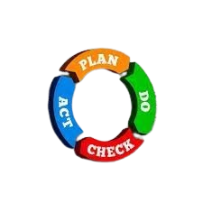
POST LAUNCH MONITORING METRICS/ITERATION
This is essential to enable InventoryMax meets its intended objectives, identify any issues quickly and make iterative improvements.
Here’s a breakdown of the key metrics and an iterative approach to guide post-launch monitoring for InventoryMax
1. ADOPTION METRICS
User Sign-ups/Activations: Number of users who have signed up and activated their accounts.
Usage Frequency: How often users log in and use the platform.
Feature Usage: Which features are being used the most and least.
Customer Onboarding Completion: Percentage of users completing the onboarding process.
Iteration: If adoption is low, consider implementing additional training, revisiting the user interface, or creating more targeted onboarding materials to help new users.
2. PERFORMANCE METRICS
System Uptime: Percentage of time the system is operational and available.
Page Load Times: Speed at which pages load, especially for inventory-heavy pages.
Error Rates: Frequency and types of errors occurring.
API Response Times: For integrations, monitor how quickly API requests are processed.
Iteration: If performance metrics fall below acceptable thresholds, work on optimizing code, reviewing server capacity, and checking for any bottlenecks in the database or integrations.
3. INVENTORY MANAGEMENT METRICS
Stock Accuracy: The alignment between reported and actual stock levels.
Inventory Turnover: How often inventory is sold and replaced.
Order Fulfillment Rate: The speed and accuracy of order processing and fulfillment.
Shrinkage: Any discrepancies due to lost or stolen inventory.
Iteration: Analyze any discrepancies in stock accuracy or turnover rates and investigate root causes, such as manual errors or system inaccuracies. Adjust algorithmic parameters if needed.

Slide 51
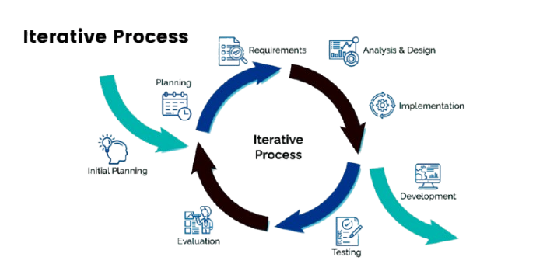


4. CUSTOMER SATISFACTION AND ENGAGEMENT
NPS (Net Promoter Score): Measure customer satisfaction and likelihood to recommend.
User Feedback & Reviews: Gather qualitative feedback through surveys, customer support, and reviews.
Support Tickets: Volume and types of support tickets raised, especially those related to critical issues.
Iteration: If NPS or feedback indicates dissatisfaction, dive deeper into the issues raised by users and prioritize fixes or updates based on impact.
6. RETENTION AND CHURN METRICS
Churn Rate: Percentage of users who stop using the platform over time.
Retention Rate: Percentage of users who continue using the platform after a certain period.
Time to First Value: How quickly users experience value from InventoryMax.
Iteration: High churn could indicate issues with usability, value perception, or system performance. Gather data on where drop-offs occur and focus on improving user experience in those areas.
5. FINANCIAL METRICS
Revenue Impact: Monitor if there’s a boost in sales and revenue due to optimized inventory.
Cost Savings: Measure any reductions in costs associated with inventory handling and storage.
Return on Investment (ROI): Calculate the ROI based on cost savings, revenue impact, and customer acquisition/retention.
Iteration: Track financial performance to ensure InventoryMax aligns with business goals, and iterate based on which levers (e.g., cost savings, revenue gains) can be optimized further.
ITERATIVE APPROACH FOR POST-LAUNCH MONITORING:
1. Weekly Metrics Review: Set up weekly dashboards to review key metrics, focusing on real-time adjustments.
2. Monthly User Feedback Loop: Conduct monthly user surveys or focus groups to gather feedback.
3. Quarterly Performance and Feature Audits: Evaluate the overall performance, feature usage, and user needs quarterly to decide on enhancements.
4. Implement A/B Testing: Test small iterations or feature improvements with a subset of users before a full rollout.
5. Continuous Improvement Roadmap: Based on metric insights, maintain a roadmap prioritizing feature enhancements, performance improvements, and user requests.
Tracking these metrics and refining the platform through iterative cycles will ensure that InventoryMax remains aligned with business goals, satisfies users, and continually improves over time.

